Slide 1
مَدْرَسَةُ الْهُدَى
نَعِيمَة مُصْطَفَى
Naima Mustapha
أُحِبُّ اللُّغَةَ العَرَبِيَّة
nmustapha@darussalaam.org

Slide 2
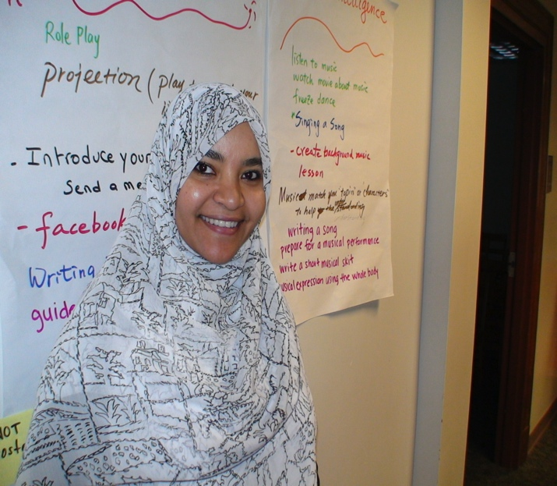
All About Me
Experience
Arabic Native Speaker
World Language Instructor (17 years)
Arabic Department Head (Alhuda School)
Professor Assistant (Concordia College) Teacher summer programs.
B.A (History) Al-Azhar University.
M.A Education (Concordia College) Moorhead, Minnesota.

Slide 3
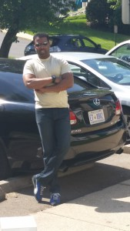
My Family
My husband
Osama
Agriculture Engineer

Slide 4
My Goals
To give you the academic and social skills you need to progress in Arabic.
To provide a supportive and fun classroom environment.
To help you discover new interests.

Slide 5
أُحِبُّ اللُّغَةَ الْعَرَبِيَّــةَ
In 6th Grade we are covering:
I love Arabic language book 4
Reading
Writing
Speaking
Lessening
Comprehension

Slide 6
أُحِبُّ اللُّغَةَ الْعَرَبِيَّــةَ
In 7th Grade we are covering:
I love Arabic language book 5
Reading
Writing
Speaking
Lessening
Comprehension

Slide 7
Reading القراءة
Reading this year will be very intensive in shaa Allah.
Stories of the Prophets.
Texts from the books

Slide 8
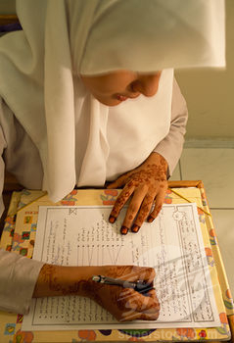
Writing
In your writing this year you should be able to:
Create statements and formulate questions based on familiar material.
Recombined sentences of the learned vocabularies and structures.
Write in all time frame (الماضي ، الحاضر، المستقبل)

Slide 9
Speaking
Express personal meaning by combining and recombining into short statements what you know and what you hear from your interlocutors
Speaks about Many topics includes daily life activities.
Speaks about some immediate needs, such as asking and answering simple questions
Notes:
Topics are related to basic personal information covering, for example:

Slide 10
Listening/Comprehension
Your teacher's voice is not the only one that your going to listen to during your Arabic Class
Different materials will be introduced to you through the year for you to watch, hear and understand
You should be able to understand sentence-length utterance which consist of recombination of learned utterances on a variety of topics.

Slide 11
Class Rules
Our classroom is a community. In our community, we have rules to help us have a good relationship with each other.
Our class rules are:
Remember that Allah (سبحانه وتعالى) is always watching you, so worship Him with Ihsan.
Be Respectful (RESPECT to other people, the environment and yourself)
Be organized and follow directions 1st time given.
Make SMART choices
Come to class PREPARD and ready to learn

Slide 12
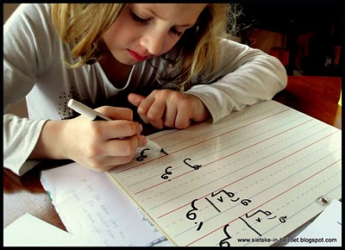
Homework
I will assign about 30 minutes of homework 3 days a week (Monday, Wednesday, and Friday).
Weekend 30 minutes of reading (minimum).
I will check all homework right after class starts. All work most be on your desk by that time
I will come by your desk once. If your homework is not on your desk at that time, it will be marked late.

Slide 13
Homework Cont...
Late work will only get Half credit.
I will accept late large assignments "100 points projects) for one week after the due date. Students lose a minimum of 5 points for each day the assignment is late.
Students will not be allowed to turn in bulk work at the end of the quarter.

Slide 14
Absences
With an excused absence, you may make up missed work for full credit.
Missed exams must be made up within ONE week.
Make-up work will be addressed outside of class "preferably right before school or during recess time)
After they have been used in class, copies of all handouts are supposed to be placed in your binder, all handouts will be placed on our class’s website.

Slide 15
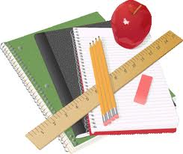
Necessary Supplies
One three ring binder (1 ½ inches)
8 dividers (Students may make the dividers out of tape and paper)
Loose leaf paper- Flash Cards
Pencils ONLY and Highlighters
Flash Cards
You may NOT use your friends' materials/supplies under any circumstances, every time you choose to do so you will lose 5 points of that day's class work.

Slide 16
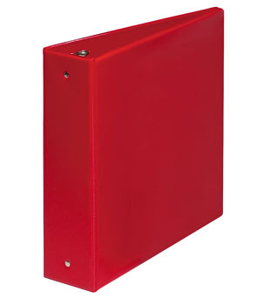
سجل الإنجازات Portfolio
Note: (1 ½ inches binder) Most of your materials will be kept in your binder. You must bring this binder to class every day. Label its dividers according to the units in your book.

Slide 17
Class Procedures
At the beginning of class:
As I enter your classroom, be seated and QUITE, open your binder and start writing the warm-up immediately, then wait for direction from the teacher
Place completed homework on your desk.
Talk only in Arabic language to communicate with me.

Slide 18
Class Procedures Cont.....
During Class
Sharpened-pencil: I do not like students to leave their desks to sharpen their pencils, please have your own sharpener then save the trash until l after class.
Bathroom: Trips to the bathroom will be eliminating specially during the first 15, but you may go during instruction if it is an absolute emergency, by raising the index finger up, I will either nod “yes” or “no”. The only time I will nod “no” is if you are missing something very important.
Water/ Locker Policy:
You may have your bottle of water with you during class. no trips to the fountains.
No one will be excused during the first or last 10 minutes of class or during certain activities.

Slide 19
Class Procedures Cont.....
During Class
Sleeping, writing notes, coloring pictures and messages will NOT be tolerated.
The notes, pictures and messages will be taken and filed for future parents conferences.
If you are sleeping during class, I will attempt to wake you only once and notify your parents of your lack of attention.
Subsequent sleeping episodes will be documented but I will not attempt to wake you. Your lack of attention will seal your fate with your failing grades!

Slide 20
Class Procedures Cont.....
«منْ غَشَّنا فليس مِنّا)
Cheating is punishable with a zero and your parents/admins will be notified.
DON’T EVEN THINK ABOUT IT! Keep in mind that your reputation can be seriously compromised by a cheating incident.
It will be impossible to write a college recommendation for you if you have been guilty of cheating.
Cheating includes the use of a cheat-sheet, asking someone an answer, or looking on someone else’s paper. DON”T DO IT!
Make sure to know check your homework daily on our class’s website.

Slide 21
Class Procedures Cont.....
At the end of Class
Pack your belongings only after you have been asked to do so.
Clean the area around your desk before you leave and remember cleanliness is part of your identity as a Muslim
Make sure to collect all the handout and keep it in your binder by the end of your class.

Slide 22
سَنَةٌ دِرَاسِيَّةٌ سَعِيدَةٌ

